Slide 1
@Component Annotation
The @Component annotation indicates that an annotated class is a “spring bean/component”.
The @Component annotation tells Spring container to automatically create Spring bean.

Slide 2
@Autowired Annotation
The @Autowired annotation is used to inject the bean automatically
The @Autowired annotation is used in constructor injection, setter injection and field injection

Slide 3
@Qualifier Annotation
@Qualifier annotation is used in conjunction with Autowired to avoid confusion when we have two or more beans configured for same type

Slide 4
@Primary Annotation
We use @Primary annotation to give higher preference to a bean when there are multiple beans of the same type

Slide 5
@Configuration
@Configuration is a class-level annotation indicating that an object is a source of bean definitions. @Configuration classes declare beans through @Bean -annotated methods. Calls to @Bean methods on @Configuration classes can also be used to define inter-bean dependencies.

Slide 6
@Bean annotation
@Bean annotation indicates that a method produces a bean to be managed by the Spring container. The @Bean annotation is usually declared in Configuration class to create Spring Bean definitions.
By default, the bean name is same as method name. We can specify bean name using @Bean(name = “beanName”).
@Bean annotation provides initMethod and destroyMethod attributes to perform certain actions after bean initialization or before bean destruction by a container.

Slide 7
Stereotype annotations
These annotations are used to create Spring beans automatically in the application context (Spring IoC container)
The main stereotype annotation is @Component
By using this annotation, Spring provides more Stereotype meta annotations such as @Service, @Repository and @Controller
@Service annotation is used to create Spring beans at the Service layer
@Repository is used to create Spring beans for the repositories at the DAO layer.
@Controller is used to create Spring beans at the controller layer.

Slide 8
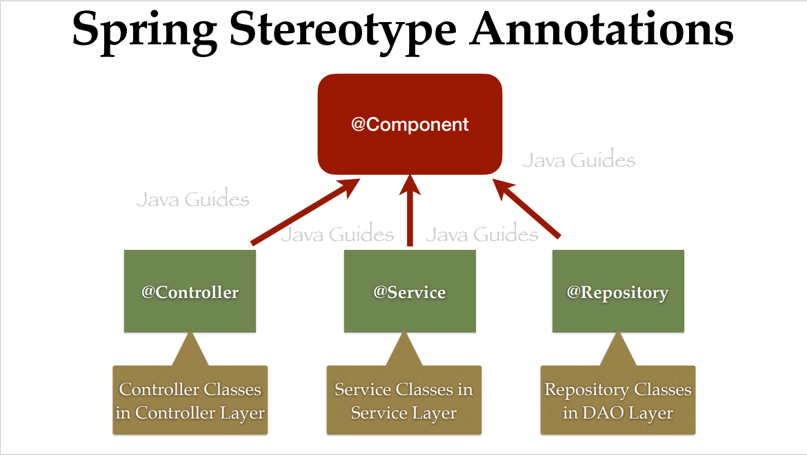

Slide 9
@Lazy Annotation
By default, Spring creates all singleton beans eagerly at the startup/bootstrapping of the application context.
You can load the Spring beans lazily (on-demand) using @Lazy annotation
@Lazy annotation can used with @Configuration, @Component and @Bean annotations
Eager initialization is recommended: to avoid and detect all possible errors immediately rather than at runtime

Slide 10
@ConfigurationProperties Annotation
@ConfigurationProperties bind external configurations to a strongly typed bean in your application code. You can inject and use this bean throughout your application code just like any other spring bean.

Slide 11
@Controller Annotation
Spring provides @Controller annotation to make a Java class as a Spring MVC controller. The @Controller annotation indicates that a particular class serves the role of a controller.
Controller in Spring MVC web application is a component that handles incoming HTTP requests.
@Controller annotation is simply a specialization of the @Component class, which allows us to auto-detect implementation classes through the classpath scanning.
We typically use @Controller in combination with a @RequestMapping annotation for request handling method.

Slide 12
@RestController Annotation

